Slide 1
Introduction to Data Science
Unit 02 Lecture 01
Dr Muhammad Ismail Mangrio

Slide 2

Contents
Defining data science and big data
Recognizing the different types of data
Gaining insight into the data science process
Introducing the fields of data science and big data

Slide 3
Introduction (Traditional Data)
Traditional data is the structured data that is being majorly maintained by all types of businesses starting from very small to big organizations.
Where a centralized database architecture used to store and maintain the data in a fixed format or fields in a file. For managing and accessing the data Structured Query Language (SQL) is used.
It is characterized by its high level of organization and structure, which makes it easy to store, manage, and analyze.
It data analysis techniques involve using statistical methods and visualizations to identify patterns and trends in the data.
It is often collected and managed by enterprise resource planning (ERP) systems and other enterprise-level applications. This data is critical for businesses to make informed decisions and drive performance improvements.

Slide 4
Introduction (Big Data)
Big data is collection of data sets so large or complex that it becomes difficult to process them using traditional data management techniques such as RDBMS.
It refers to a massive amount of data that keeps on growing exponentially with time. It is so voluminous that it cannot be processed or analyzed using conventional data processing techniques.
The European Commission defines Big Data as: “large amounts of different types of data produced from various types of sources, such as people, machines or sensors”.
  Big Data examples are transaction processing systems, customer databases, documents, emails, medical records, internet clickstream logs, mobile apps and social networks.
The widely adopted RDBMS has long been regarded as a one-size-fits-all solution, but the demands of handling big data have shown otherwise.

Slide 5
Introduction (Big Data)
The characteristics of big data are often referred to as the four Vs
  Volume: How much data is there? big data refers to extremely large datasets that cannot be easily managed or processed using traditional technologies.
  Variety: How diverse are different types of data? Traditional data is typically structured, means it is organized in a predefined manner such as tables, columns, and rows. Big data, on the other hand, can be structured, unstructured, or semi-structured, meaning it may contain text, images, videos, or other types of data.
  Velocity: At what speed is new data generated? Traditional data is usually static and updated on a periodic basis. In contrast, big data is constantly changing and updated in real-time or near real-time.
  Veracity: How accurate is the data? What about 5th V?
These four properties make big data different from the data found in traditional data management tools.

Slide 6

Facets/types of Data
In data science and big data you’ll come across many different types of data. The main categories of data are these:
  Structured
  Unstructured
  Natural language
  Machine-generated
  Graph-based
  Audio, video, and images
  Streaming

Slide 7
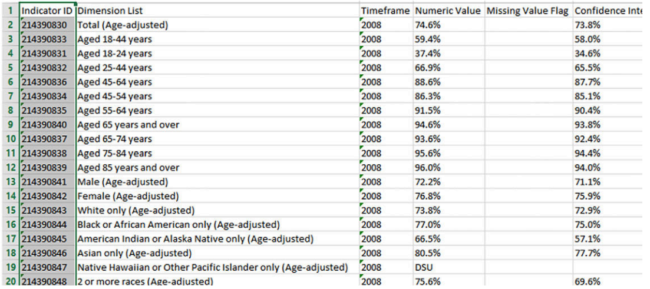
Structured Data
Structured data depends on a data model and resides in a fixed field within a record. Like in MS-Excel, RDBMS, etc.
The world isn’t made up of structured data, though; it’s imposed upon it by humans and machines. More often, data comes unstructured.

Slide 8
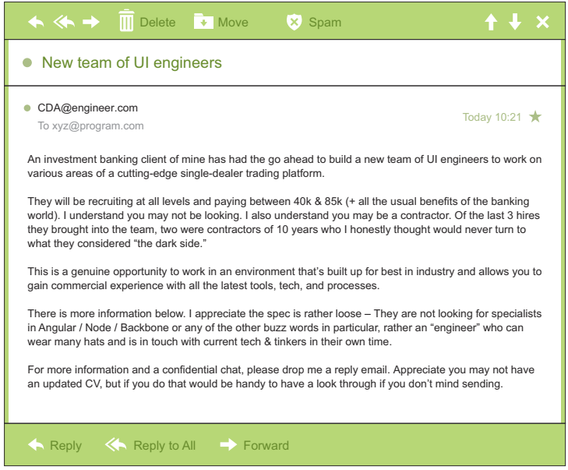
Unstructured Data
Unstructured data isn’t easy to fit into a data model because the content is context-specific or varies.
  Example: regular email.
Although email contains structured elements such as the sender, title, and body text, it’s a challenge to find the number of people who have written an email complaint about a specific employee because so many ways exist to refer to a person, for example. The thousands of different languages and dialects out there further complicate this.
A human-written email is also a perfect example of natural language data.

Slide 9
Natural language
Natural language is a special type of unstructured data
It’s challenging to process because it requires knowledge of specific data science techniques and linguistics.
The natural language processing (NLP) community has had success in Entity recognition, topic recognition, summarization, text completion, and sentiment analysis.
However, models trained in one domain don’t generalize well to other domains.
Example: In sentiment analysis, the meaning of the same words can vary when coming from someone upset or joyous.

Slide 10
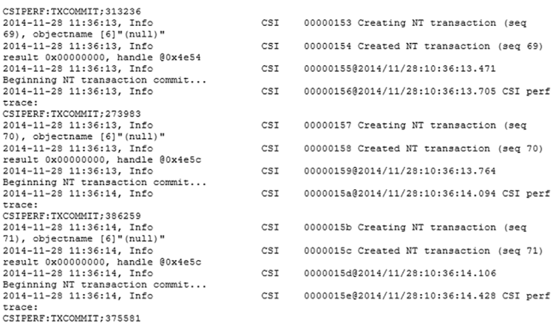
Machine Generative Data
Machine-generated data is information that’s automatically created by a computer, process, application, or other machine without human intervention. It is becoming a major data resource and will continue to do so.
Examples of machine data are web server logs, call detail records, network event logs, data from IoT, and telemetry.
The machine data shown in Figure would fit nicely in a classic table-structured database.

Slide 11
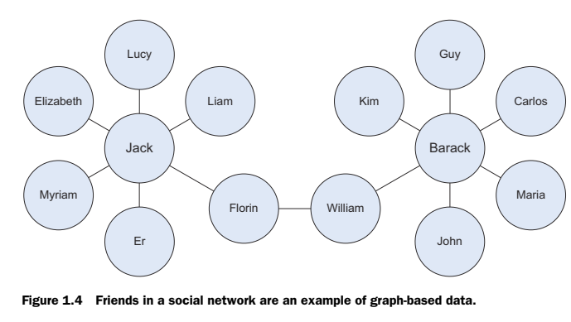
Graph-based or network data
A graph is a mathematical structure to model pair-wise relationships between objects.
Graph or network data is data that focuses on the relationship or adjacency of objects.
The graph structures use nodes, edges, and properties to represent and store graphical data.
Graph-based data is a natural way to represent social networks, and its structure allows you to calculate specific metrics such as the influence of a person and the shortest path between two people.

Slide 12
Audio, image, and video
  Audio, image, and video are data types that pose specific challenges to a data scientist.
  Tasks that are trivial for humans, such as recognizing objects in pictures, turn out to be challenging for computers as well.
  A company called DeepMind created an algorithm that’s capable of learning how to play video games. This algorithm takes the video screen as input and learns to interpret everything via a complex process of deep learning. It’s a remarkable feat that prompted Google to buy the company for their own Artificial Intelligence (AI) development plans.

Slide 13
Streaming data
While streaming data can take almost any of the previous forms, it has an extra property.
The data flows into the system when an event happens instead of being loaded into a data store in a batch.
  Examples are the “What’s trending” on X (Twitter), live sporting or music events, and the stock market.

Slide 14
The big data ecosystem and data science
Currently many big data tools and frameworks exist, and it’s easy to get lost because new technologies appear rapidly.
Big data ecosystem can be grouped into technologies that have similar goals and functionalities.

Slide 15
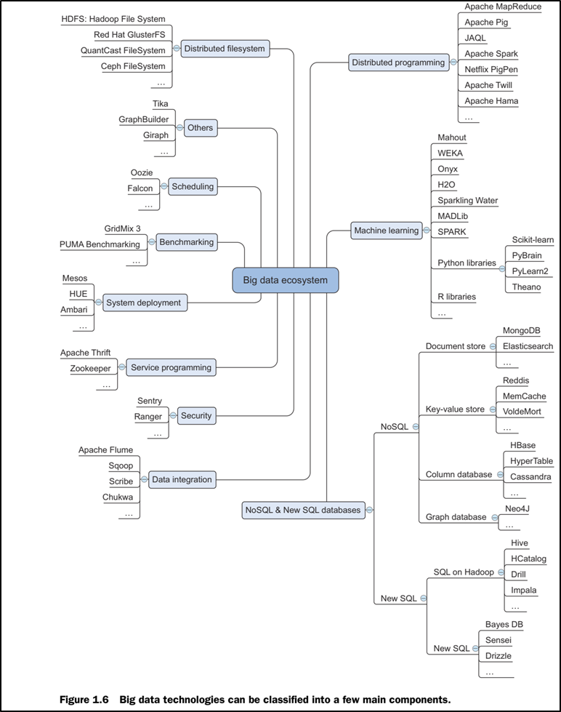
The big data ecosystem and data science

Slide 16
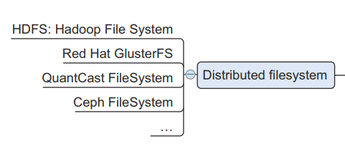
Distributed file system
It is similar to a normal file system, except that it runs on multiple servers at once. Because it’s a file system, you can do almost all the same things you’d do on a normal file system. Actions such as storing, reading, and deleting files and adding security to files are at the core of every file system, including the distributed one. Advantages:
  Store files larger than any one computer disk.
  Files get automatically replicated across multiple servers for redundancy or parallel operations while hiding the complexity of doing so from the user.
  The system scales easily: you’re no longer bound by the memory or storage restrictions of a single server.
  Best examples: HDFS and GFS

Slide 17
Distributed Programming Framework
Once you have the data stored on the DFS, you want to exploit it.
One important aspect of working on a distributed hard disk is that you won’t move your data to your program, but rather you’ll move your program to the data.
When you used programming languages like C, Python, or Java, you need to deal with the complexities that come with distributed programming, such as restarting jobs that have failed, tracking the results from the different subprocesses, and so on.
Luckily, the open-source community has developed many frameworks to handle this for you, and these give you a much better experience working with distributed data and dealing with many of the challenges it carries.
    Apache MapReduce
    Apache Pig
    Apache Spark etc

Slide 18
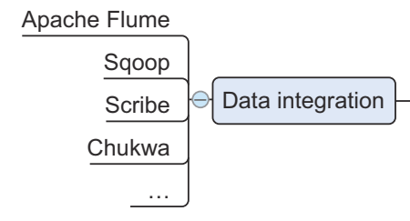
Data Integration Framework
Once you have a DFS in place, you need to add data.
When there is a need to move data from one source to another, data integration frameworks such as Apache Sqoop and Apache Flume are particularly effective.
  Sqoop = SQL + Hadoop
  Flume = Flow of logs.
The process is similar to an extract, transform, and load process in a traditional data warehouse.

Slide 19
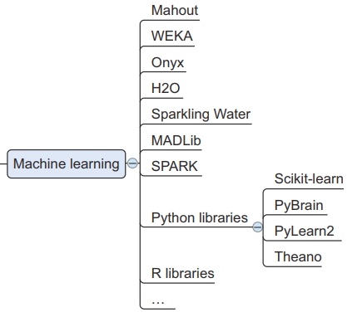
Machine learning frameworks
Once the data is collected and stored, the next step is to extract valuable insights. This is where machine learning, statistics, and applied mathematics come into play.
👉 Machine learning is “a field of study that gives computers the ability to learn without being explicitly programmed.”
Given the massive volumes of data we deal with today, traditional methods are often insufficient. To handle this challenge, we rely on specialized frameworks and libraries.
For Python, the most widely used machine learning library is Scikit-learn, which provides tools for data analysis, modeling, and prediction.

Slide 20
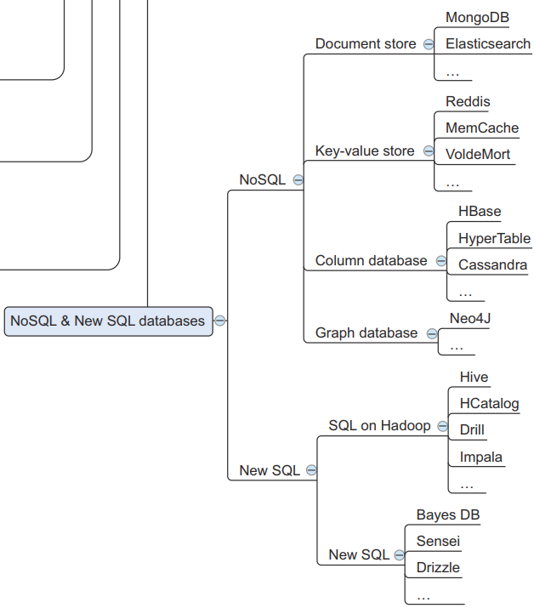
NoSQL Databases
Traditionally, this has been the playing field of relational databases such as Oracle SQL, MySQL, Sybase IQ, and others.
While they’re still the go-to technology for many use cases, new types of databases have emerged under the grouping of NoSQL databases.
The name of this group can be misleading, as “No” in this context stands for “Not Only.” A lack of functionality in SQL isn’t the primary reason for the paradigm shift, and many NoSQL databases have implemented a version of SQL themselves.
But traditional databases had shortcomings that didn’t allow them to scale well. By addressing several of the limitations of traditional databases, NoSQL databases enable virtually unlimited data growth.
These shortcomings relate to every property of big data: their storage or processing power can’t scale beyond a single node, and they have no way to handle streaming, graph, or unstructured forms of data.

Slide 21
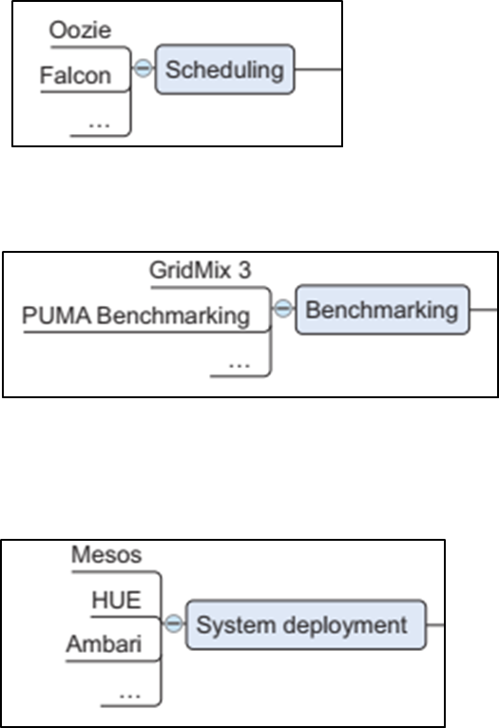
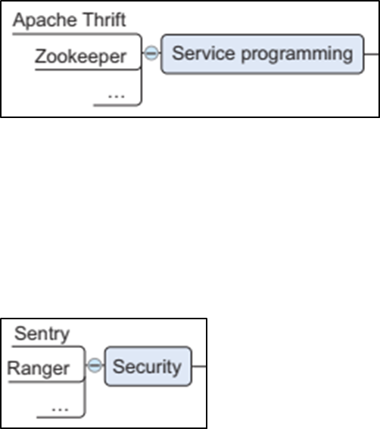
Other tools
Scheduling tools
Benchmarking tools
System deployment
Service programming
Security

Slide 22
What is Data Science
It was a great challenge and concern for industries for the storage of data until 2010.
Now that frameworks like Hadoop and others have solved the problem of storage, the focus has shifted to processing of data. Data Science plays a big role here.
Data science is a field that involves using statistical and computational techniques to extract insights and knowledge from data.
  It is an evolutionary extension of statistics capable of dealing with the massive amounts of data produced today. It adds methods from CS to the repertoire of statistics
  One of the primary goals of data science is to extract insights from data that can be used to inform decision-making.
    This may involve identifying patterns or trends in data, making predictions about future outcomes, or identifying opportunities for optimization or improvement.
  It encompasses a wide range of tasks, including data cleaning and preparation, data visualization, statistical modeling, machine learning, and more.
Data scientists use these techniques to discover patterns and trends in data, make predictions, and support decision-making.

Slide 23

Benefits and uses of data science and big data
Both are used almost everywhere in both commercial and non-commercial settings.
Commercial companies in almost every industry use data science and big data to gain insights into their customers, processes, staff, completion, and products.
Many companies use data science to offer customers a better user experience, as well as to cross-sell, up-sell, and personalize their offerings.
A good example of this is Google AdSense, which collects data from internet users so relevant commercial messages can be matched to the person browsing the internet.

Slide 24
Benefits and uses of data science and big data
HR professionals use people analytics and text mining to screen candidates, monitor the mood of employees, and study informal networks among co-workers.
Financial institutions use data science to predict stock markets, determine the risk of lending money, and learn how to attract new clients for their services.
Governmental organizations are also aware of data’s value. Many governmental organizations not only rely on internal data scientists to discover valuable information, but also share their data with the public. You can use this data to gain insights or build data-driven applications.
  Data.gov is but one example; it’s the home of the US Government’s open data

Slide 25
Benefits and uses of data science and big data
Nongovernmental organizations (NGOs) use it to raise money and defend their causes.
  The World Wildlife Fund (WWF), for instance, employs data scientists to increase the effectiveness of their fundraising efforts.
The rise of massive open online courses (MOOCs) produces a lot of data, which allows universities to study “how this type of learning can complement traditional classes”.

Slide 26
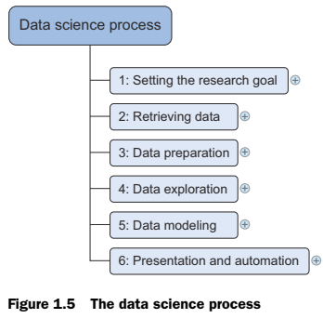
The data science process
The data science process typically consists of six steps,
Research goals: A project starts by understanding the what, the why, and the how of your project.
Retrieving Data: checking the existence of quality and access to the data. Data can be internal or external, i.e., delivered by third-party companies.
Data preparation: Data collection is an error-prone process. Thus, the data preparation phase consists of three subphases:
  data cleansing removes false values from a data source and inconsistencies across data sources
  data integration enriches data sources by combining information from multiple data sources
  data transformation ensures that the data is in a suitable format for use in your models.
Notes:
Research Goals
Write down in your own words:
What is the problem?
Why does it matter to the company?
How might data help solve it?
Retrieving Data
Assume you have access to:
Customer transaction history (internal)
Customer demographics (internal)
Market trends from a third-party report (external)
Identify which data sources would be most important for churn analysis.
Data Preparation
List examples of issues you might face in the data, such as:
Missing values, duplicate records, inconsistent formats.
Suggest one method each for:
Data cleansing
Data integration
Data transformation

Slide 27
The data science process
Data Exploration: is concerned with building a deeper understanding of your data. You try to understand how variables interact with each other, the distribution of the data, and whether there are outliers. To achieve this, you mainly use descriptive statistics, visual techniques, and simple modeling. This step often goes by the abbreviation EDA, for Exploratory Data Analysis.
Data modeling: Use models, domain knowledge, and insights about the data you found in the previous steps to answer the research question. You select a technique from the fields of statistics, ML, operations research, and so on. Building a model is an iterative process that involves selecting variables for the model, executing the model, and performing model diagnostics.
Finally, present the results to your business. These results can take many forms, ranging from presentations to research reports.
It is an Iterative process.
Notes:
Data Exploration (EDA)
Describe at least 3 things you would check in the dataset (e.g., outliers, distributions, correlations).
Suggest one visualization you would create to understand customer behavior.
Data Modeling
Choose a simple model you could use (e.g., Logistic Regression, Decision Tree).
Explain briefly why you chose it.
Identify one variable you think would be important for predicting churn.
Presenting Results
If your model shows that customers with low engagement are more likely to churn:
How would you present this finding to a technical team?
How would you present it to a business manager?

Slide 28
Summary
In this lecture, we discuss the following topics:
  What is Big Data and its ecosystem
  Data types
  What is Data Science and its process

